Slide 1
Self Parking Car
Taking Automation in Cars to the Next Level

Slide 2
Introduction
Parking is arguably one of the biggest challenges when it comes to driving cars. According to the Insurance Institute for Highway Safety, 14% of car crashes occur in parking lots. This does not come as a major surprise, considering even experienced drivers can struggle with parking when faced with some of its major challenges, such as space, terrain, incoming traffic, etc.
The model being proposed here will allow a car to take into account the surroundings and park in the desired spot by itself without any mishaps, and with no human intervention required.

Slide 3
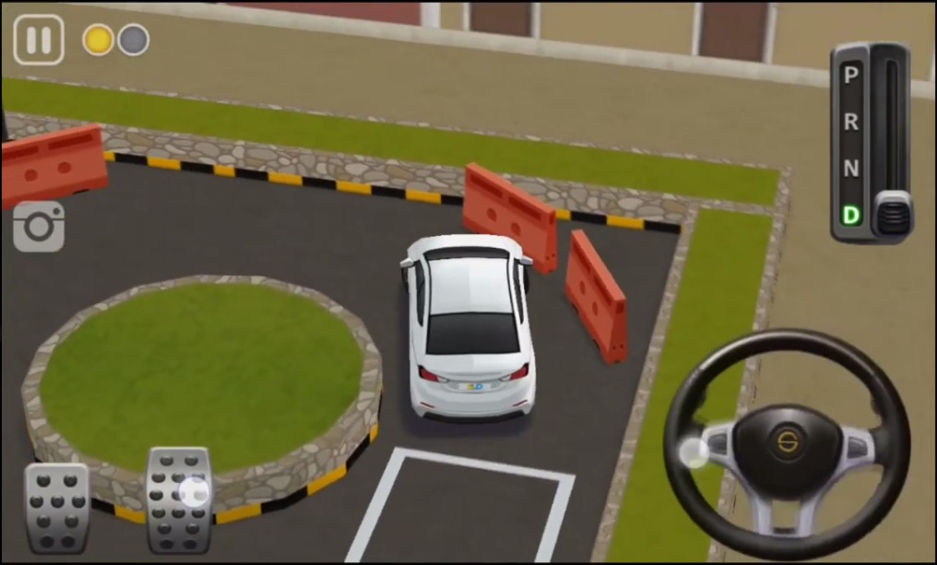
Proposed Plan
For the purpose of developing the model, the mobile game ‘Dr. Parking 4’ is being used. To run it on a desktop computer for model testing, the BlueStacks emulator has been used. The model will aim to clear the practice stages of this game.

Slide 4
How It Works
A hybrid LSTM-CNN network will take in video footage from the game, which, along with its own inputs into the game will be used for decision making.
The game allows changing of camera views, tests will start with no changes permitted to the camera view in order to reduce the complexity that the model initially deals with.
A genetic algorithm will be used for training to achieve consistent results with the model.

Slide 5
Inspiration for the Project
A large number of videos highlight attempts to develop AI models that can play popular video games. Some games where AI models have been developed include Trackmania, Minecraft and Rocket League.
At the same time, there exist a number of games that provide extremely realistic simulations of driving of vehicles. These games can be found on mobile, console and on PC.
Considering that a completely self driving car requires a more sophisticated model, we decided to address the relatively smaller problem of self parking cars.

Slide 6




Concept Sources

Slide 7
Potential Impact
In the current market, self parking systems in cars are limited, with most requiring some form of human intervention. These systems are often found lacking in reliability.
The proposed model is being built on a game which closely resembles automatic cars, with the aim of performing fully autonomous parking without any mishaps. Success of the model can lead to the development of more reliable self parking systems.

Slide 8
References
https://github.com/trekhleb/self-parking-car-evolution
https://www.youtube.com/watch?v=ovIykchkW5I
https://www.youtube.com/watch?v=DJtK0bmSMGs&t=13s
https://www.youtube.com/watch?v=KecMlLUuiE4
https://www.youtube.com/watch?v=Dw3BZ6O_8LY&t=1s

